Slide 1
UMM Distribution Company
Group Id: cs261f22finalpid33
Group Members:
2021-CS-63 Mutaiba Mohsin
2021-CS-77 Uswa Arif
2021-CS-86 Mahnoor Hassan

Slide 2
Introduction
The idea has been taken from a Tea Distribution Company.
Covers all operations in oriented working environment.
Deliveries by finding a shortest path by using a map.
Complete Order Management modules to collect ordered data of Customers,
sending bill digitally (email).
Expired Stock is removed.
Refill of Out of Stock products.
Complete Budgets, Loses and Purchases managements.

Slide 3
Features
Data Management (Employers, Riders, Product and Customer.)
Transport Management.
Order Management.
Stock Management
Expense Managements.

Slide 4
Working
The product manufactured in the factory then goes to the head office from where it is
distributed to retail stores all over Pakistan.
The Head work is to work in the benefit of the company controlling everything electronically.
The employee enters the order by customer into the system for the product in the stock.
The expired stock or less than threshold are refill, no order can be placed.

Slide 5
Cont.
The orders are maintained and assigned to the rider.
The order payment method can be entered too.
The rider has record of the order assigned to them.
The order delivered is notified by rider, can be tracked by employee using maps.
The final report can be seen by employee between months/sells and product/sells.

Slide 6
Technology Stack
Language:
C#
IDEs:
Windows form
VS Code19
Word
StarUML
JustInMind
Latex

Slide 7
Project Actors
Employee
Inventory Employee
Expense Employee
Sales Agent
Rider
Manager

Slide 8
Use Cases
Sign-in Page (U01)
Create Account(U02)
Add Rider (U03)
Edit Rider (U04)
Remove Rider (U05)
Add Order (U06)
Edit Order (U07)
Remove Order (U08)
Add Employee (U09)
Edit Employee (U10)
Remove Employee (U11)
Add Product (U12)
Edit Product (U13)
Remove Product (U14)
Manage Expense (U15)
Short path of map (U16)
Send Email (U17)
Make graph (U18)
Deliver Order Product (U19)
Location of customers(U20)
Payment Update(U21)
Searching Implementation(U22)
UI Designing(U23)

Slide 9
User Interfaces
There are total 33 Ui Screens:
Login (I01)
Sign Up (I02)
Reset Password (I03)
Manager Menu (I04)
Employee Menu (I05)
Riders Menu (I06)
Add Product (I07)
View Product (I08)
Edit Product (I09)
Add Order (I10)
View Order (I11)
Search Order (I12)
Edit Order (I13)
Add Employee (I14)
View Employee (I15)
Search Employee(I16)

Slide 10
Cont.
Edit Employee(I17)
Employee Salary Status(I18)
Map Location(I19)
Employee Profile(I20)
Add Rider(I21)
View Rider(I22)
Edit Rider(I23)
Search Rider(I24)
Rider Salary Status(I25)
Location of Customers(I26)
Rider Profile(I27)
Ordered Products(I28)
Payment of Customers(I29)
Company’s Profit(I30)
Send Email(I31)
Stock(I32)
Graph(I33)

Slide 11
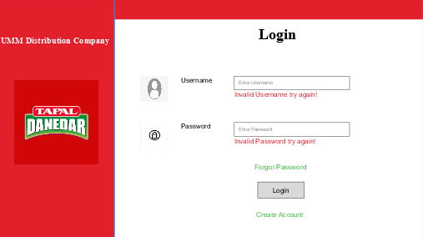
User Interfaces
Some of the UI Screens includes:

Slide 12
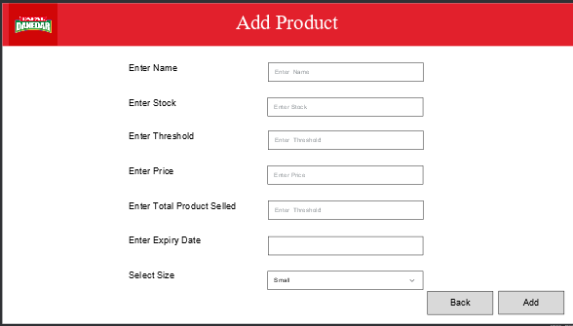
Cont.

Slide 13
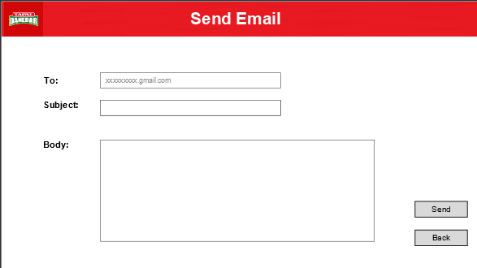
Cont.

Slide 14
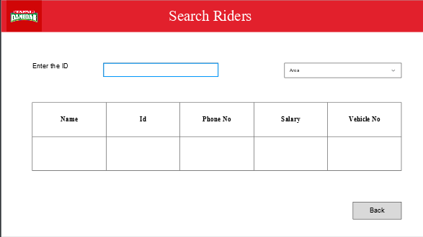
Cont.

Slide 15
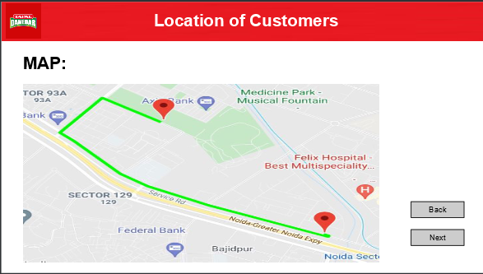
Cont.

Slide 16
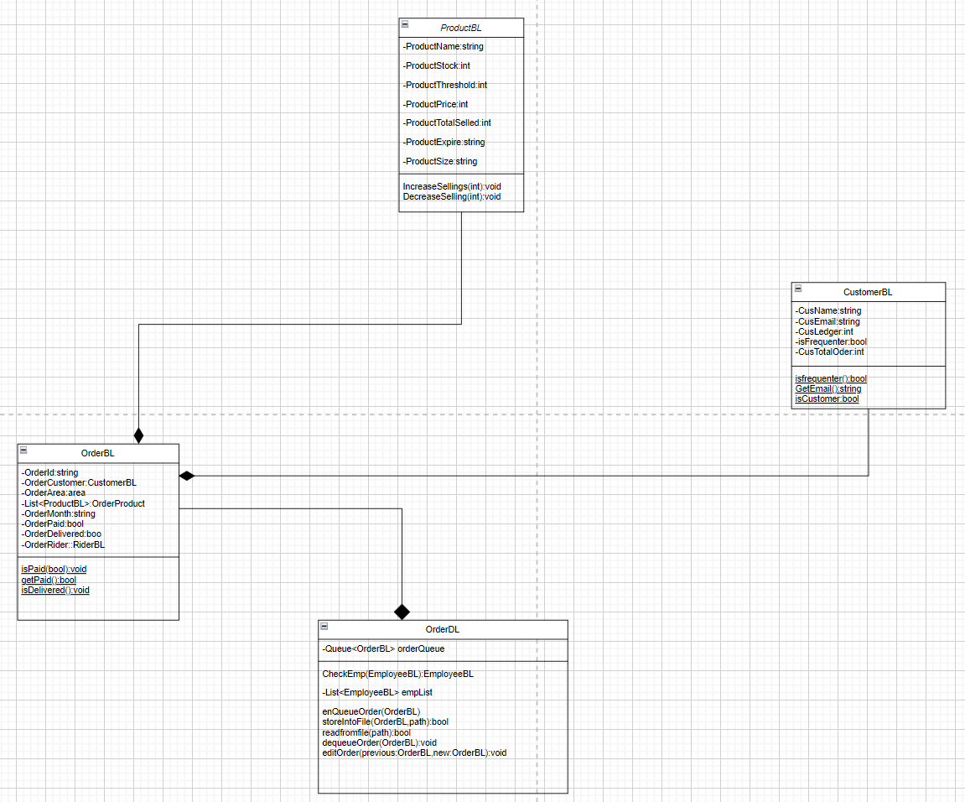
Object Oriented Features
Total classes 15
Composition
As we are dealing with BL,DL classes
so there is composition in those class
such as UserBL->UserDL,
ProductBL->ProductDL
OrderBL->ProductBL->CustomerBL

Slide 17
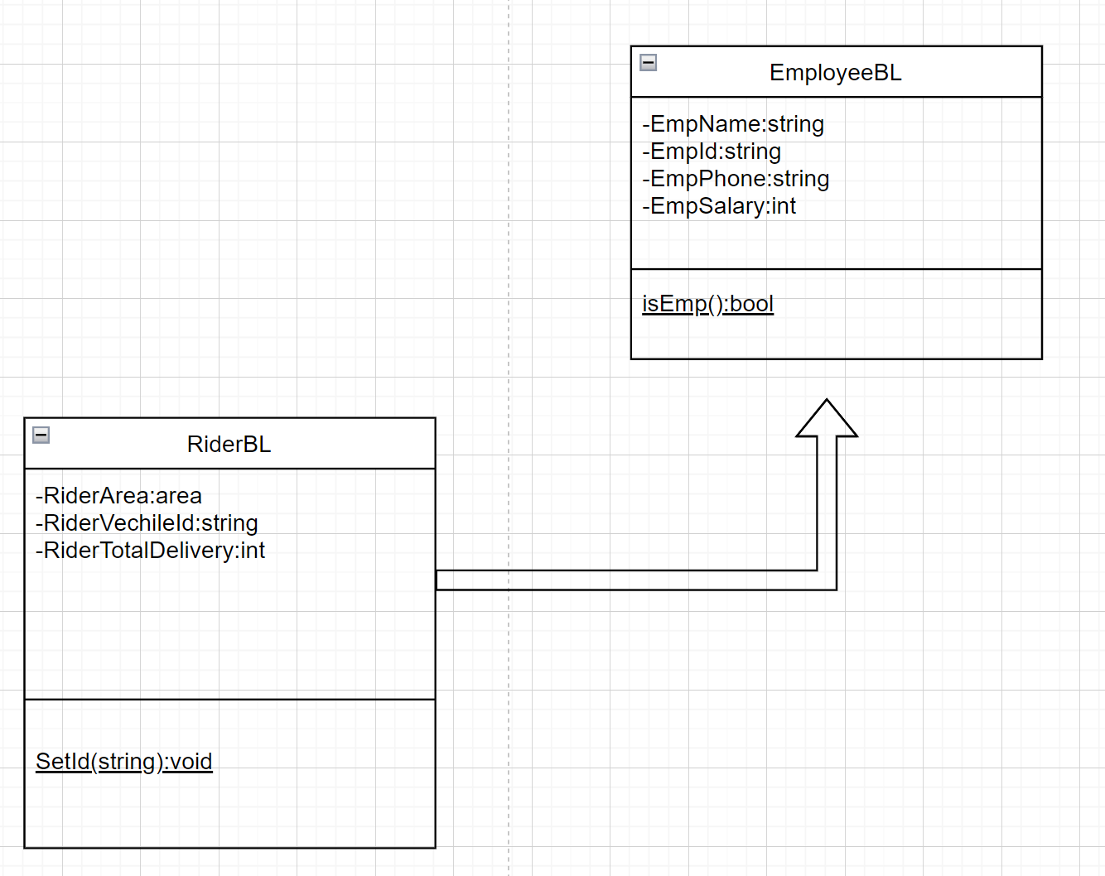
Inheritance
The rider is also an employee but it has some extra features so the RiderBL , class having information about Rider inherits the EmployeeBL

Slide 18
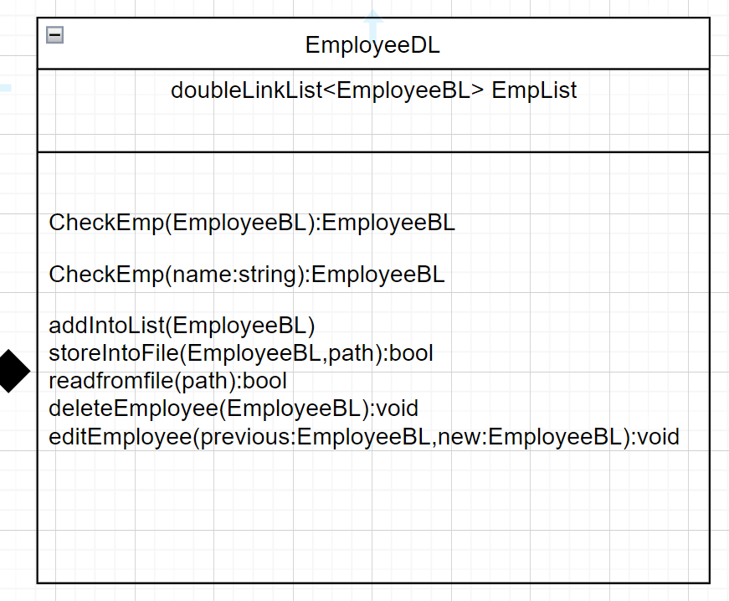
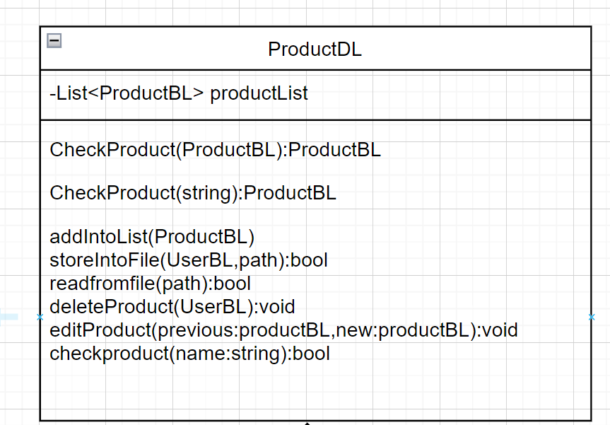
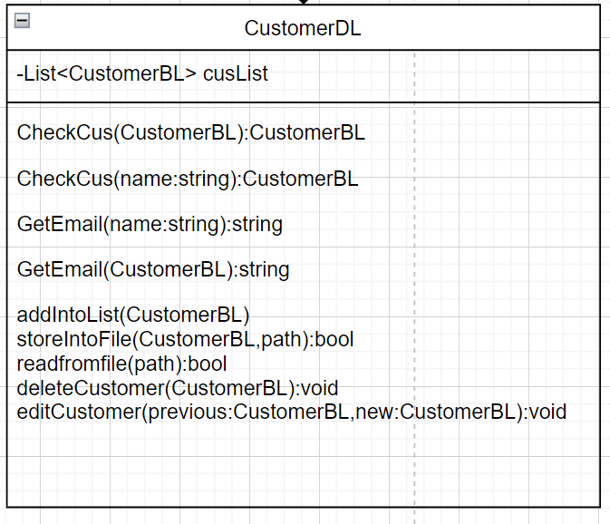
Polymorphism
The class having function CheckEmp which can check the Employee Existence function by the object or through its name.
Similarly for product checking function through name and object
Get email from customer through name and object

Slide 19
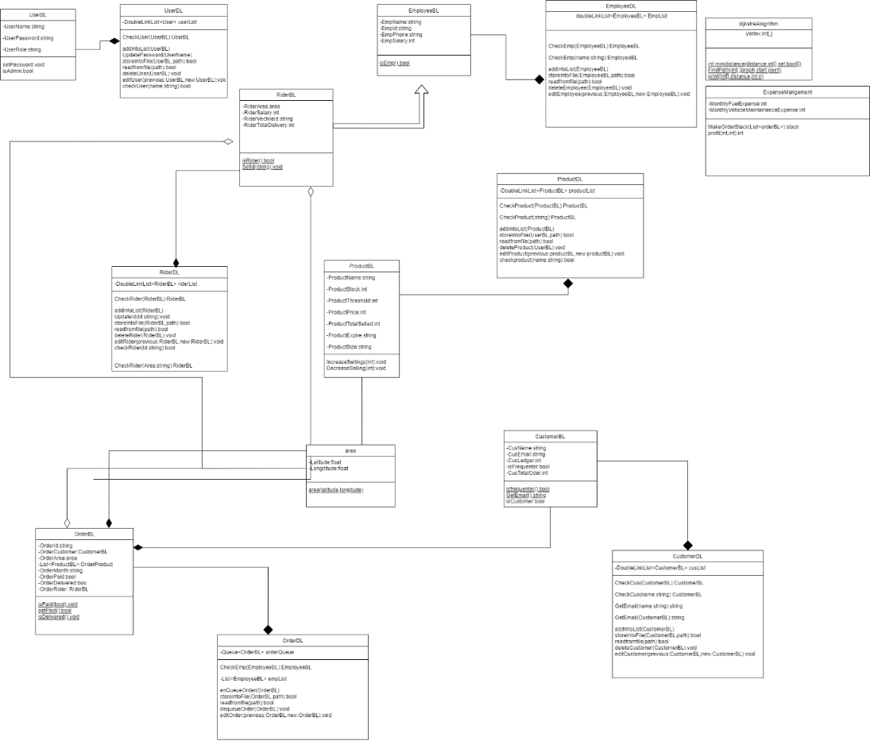
Detailed Class Diagram

Slide 20
Data Structures
AVL Tree for searching , the doubly LinkList is converted into AVL tree and then the searching is applied as its time complexity is O(lgn)
Doubly LinkList data of newly added data are stored in the doubly LinkList as insertion and deletion takes O(1).
Queue data of newly added orders and already added are stored in the Queue as insertion in O(1)and deletion, searching takes O(n), Also it will follow FIFO policy.

Slide 21
Exceptions
Invalid User
Repetition
Unavailability
Host Error
Data Storage
.csv format

Slide 22
Work Flow
Login
Data Entry
Send Email
Orders
Rider
Orders Delivered
Expense Management

Slide 23
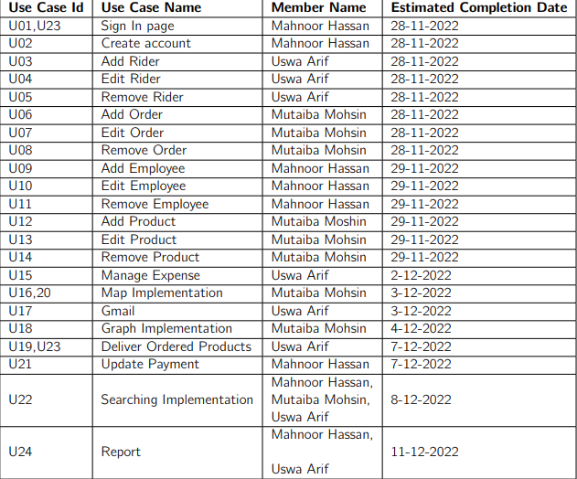
Project Plan

